Slide 1
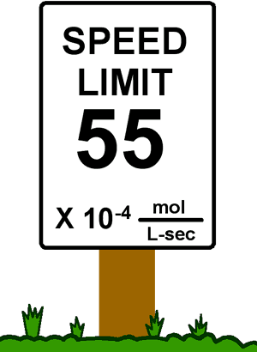
Chapter 12
Chemical Kinetics

Slide 2
12.1 Reaction Rates
12.2 Rate Laws: An Introduction
12.3 Determining the Form of the Rate Law
12.4 The Integrated Rate Law
12.5 Reaction Mechanisms
12.6 A Model for Chemical Kinetics
12.7 Catalysis

Slide 3
Reaction Rate
Change in concentration of a reactant or product per unit time.
[A] means concentration of A in mol/L; A is the reactant or product being considered.

Slide 4
Factors that Affect Reaction Rate
Temperature
Collision Theory: When two chemicals react, their molecules have to collide with each other with sufficient energy for the reaction to take place.
Kinetic Theory: Increasing temperature means the molecules move faster.
Concentrations of reactants
More reactants mean more collisions if enough energy is present
Catalysts
Speed up reactions by lowering activation energy
Surface area of a solid reactant
Bread and Butter theory: more area for reactants to be in contact
Pressure of gaseous reactants or products
Increased number of collisions

Slide 5
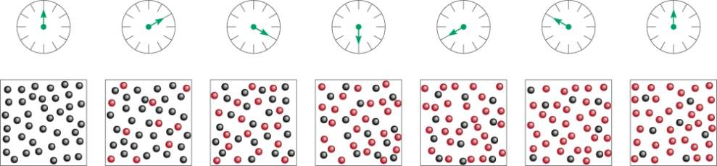
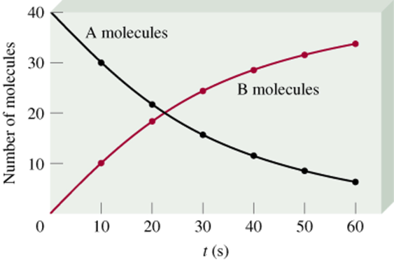
A B
time
Δ[A]
rate = -
Δt
Δ[B]
rate =
Δt
13.1

Slide 6
Instantaneous Rate
Value of the rate at a particular time.
Can be obtained by computing the slope of a line tangent to the curve at that point.

Slide 7
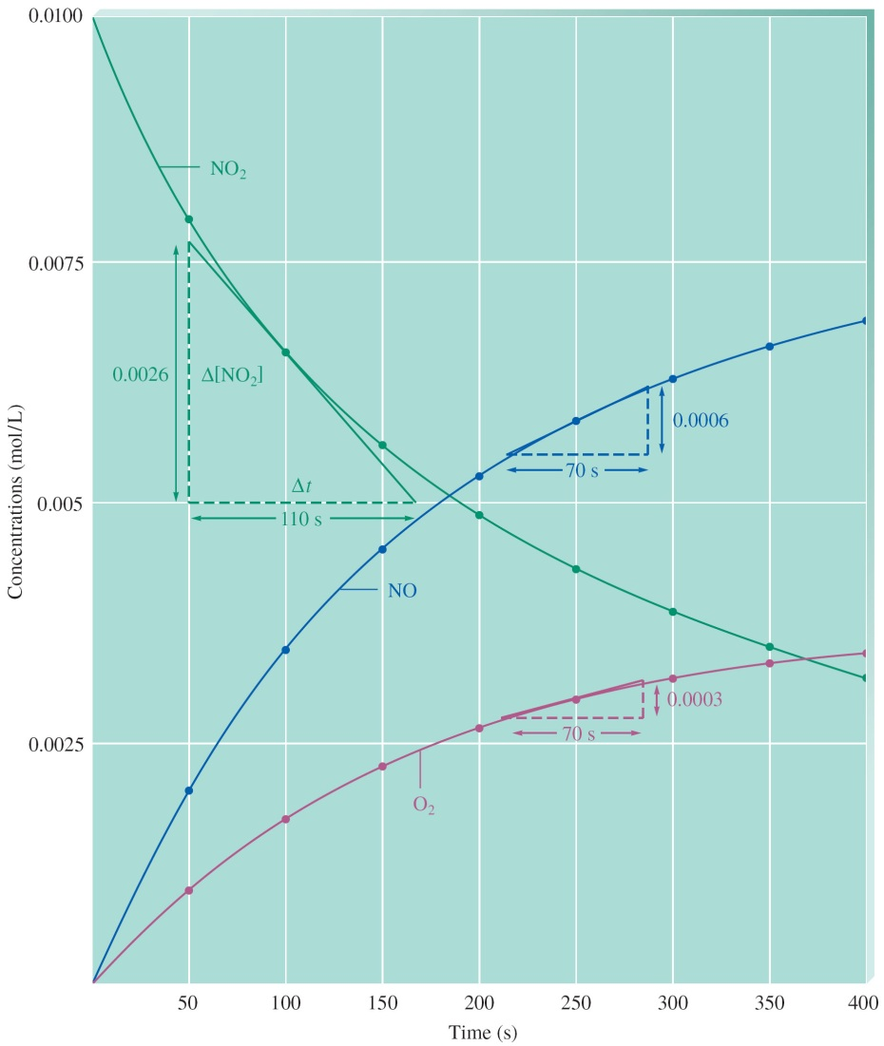
The Decomposition of Nitrogen Dioxide

Slide 8
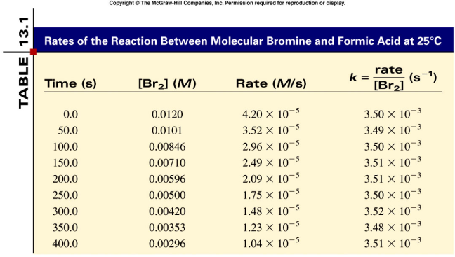
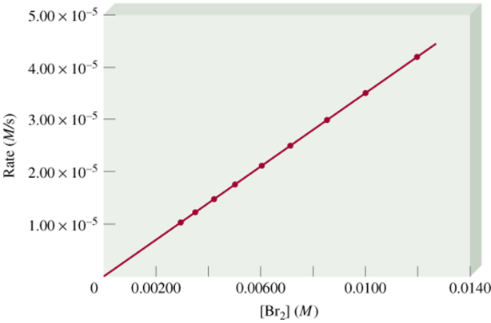
rate α [Br₂]
rate = k [Br₂]
rate
k =
= rate constant
[Br₂]
= 3.50 x 10-3 s-1
13.1

Slide 9
Rate Law
Shows how the rate depends on the concentrations of reactants.
Rate = k[A]^{n}[B]^{m}…
Example: For the decomposition of nitrogen dioxide: 2NO₂(g) → 2NO(g) + O₂(g)
Rate = k[NO₂]^{n}:
k = rate constant
n, m = order of the individual reactant

Slide 10
Rate Law
Rate = k[NO₂]^{n}
The concentrations of the products do not appear in the rate law because the reaction rate is being studied under conditions where the reverse reaction does not contribute to the overall rate.

Slide 11
Rate Law
Rate = k[NO₂]^{n}
The value of the exponent n must be determined by experiment; it cannot be written from the OVERALL balanced equation.

Slide 12
Types of Rate Laws
Differential Rate Law (rate law) – shows how the rate of a reaction depends on concentrations.
Integrated Rate Law – shows how the concentrations of species in the reaction depend on time.

Slide 13
Rate Laws: A Summary
Because we typically consider reactions only under conditions where the reverse reaction is unimportant, our rate laws will involve only concentrations of reactants.
Either type of rate law is fine to use

Slide 14
Rate Laws: A Summary
Experimental convenience usually dictates which type of rate law is determined experimentally.
Knowing the rate law for a reaction is important mainly because we can usually infer the individual steps involved in the reaction from the specific form of the rate law.

Slide 15
Determine experimentally the power to which each reactant concentration must be raised in the rate law.

Slide 16
Method of Initial Rates
The value of the initial rate is determined for each experiment at the same value of t as close to t = 0 as possible.
Several experiments are carried out using different initial concentrations of each of the reactants, and the initial rate is determined for each run.
The results are then compared to see how the initial rate depends on the initial concentrations of each of the reactants.

Slide 17
Overall Reaction Order
The sum of the exponents in the reaction rate equation.
Rate = k[A]^{n}[B]^{m}…
Overall reaction order = n + m…
k = rate constant
[A] = concentration of reactant A
[B] = concentration of reactant B

Slide 18
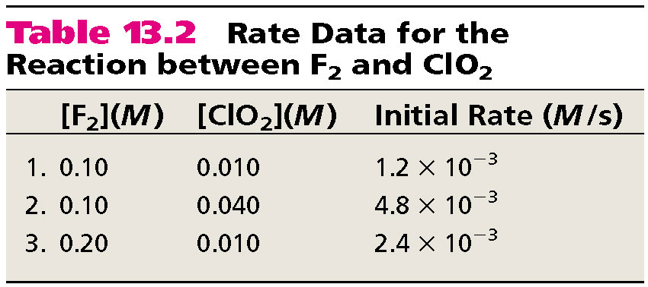
F₂ (g) + 2ClO₂ (g) 2FClO₂ (g)
rate = k [F₂]x[ClO₂]y
Double [F₂] with [ClO₂] constant
Rate doubles
x = 1
rate = k [F₂][ClO₂]
Quadruple [ClO₂] with [F₂] constant
Rate quadruples
y = 1
13.2

Slide 19
Run # | Initial [A] ([A]₀) | Initial [B] ([B]₀) | Initial Rate (v₀)
1 | 1.00 M | 1.00 M | 1.25 x 10⁻² M/s
2 | 1.00 M | 2.00 M | 2.5 x 10⁻² M/s
3 | 2.00 M | 2.00 M | 2.5 x 10⁻² M/s
What is the order with respect to A?
What is the order with respect to B?
What is the overall order of the reaction?
0
1
1

Slide 20
[NO_{(g)}] (mol dm⁻³) | [Cl_{2(g)}] (mol dm⁻³) | Initial Rate (mol dm⁻³ s⁻¹)
0.250 | 0.250 | 1.43 x 10⁻⁶
0.250 | 0.500 | 2.86 x 10⁻⁶
0.500 | 0.500 | 1.14 x 10⁻⁵
What is the order with respect to Cl₂?
What is the order with respect to NO?
What is the overall order of the reaction?
1
2
3

Slide 21
Determine the rate law and calculate the rate constant for the following reaction from the following data:
S₂O₈2- (aq) + 3I- (aq) 2SO₄2- (aq) + I₃- (aq)
Experiment | [S₂O₈²⁻] | [I⁻] | Initial Rate (M/s)
1 | 0.08 | 0.034 | 2.2 x 10⁻⁴
2 | 0.08 | 0.017 | 1.1 x 10⁻⁴
3 | 0.16 | 0.017 | 2.2 x 10⁻⁴
rate = k [S₂O₈2-]x[I-]y
y = 1
x = 1
rate = k [S₂O₈2-][I-]
Double [I-], rate doubles (experiment 1 & 2)
Double [S₂O₈2-], rate doubles (experiment 2 & 3)
rate
2.2 x 10-4 M/s
k =
=
= 0.08/M•s
[S₂O₈2-][I-]
(0.08 M)(0.034 M)
13.2

Slide 22
First-Order
Rate = k[A]
Integrated:
ln[A] - ln[A]_{o} = –kt (form of “Pert”)
[A] = concentration of A at time t
k = rate constant
t = time
[A]_{o} = initial concentration of A

Slide 23
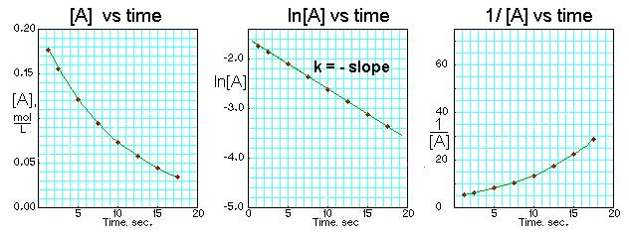
First-Order Reactions
Δ[A]
[A] = [A]₀e-kt
rate = -
rate = k [A]
Δt
[A] is the concentration of A at any time t
ln[A] - ln[A]₀ = - kt
[A]₀ is the concentration of A at time t=0
13.3

Slide 24
The reaction 2A B is first order in A with a rate constant of 2.8 x 10-2 s-1 at 800C. How long will it take for A to decrease from 0.88 M to 0.14 M ?
[A] = [A]₀e-kt
[A]₀ = 0.88 M
ln[A] - ln[A]₀ = - kt
[A] = 0.14 M
ln[A]₀ - ln[A] = kt
[A]₀
0.88 M
ln
ln
ln[A]₀ – ln[A]
[A]
0.14 M
t =
=
=
= 66 s
k
k
2.8 x 10-2 s-1
13.3

Slide 25

Half-Life of Reactions

Slide 26
First-Order
Half–Life:
k = rate constant

Slide 27
First-Order Reactions
The half-life, t_{½}, is the time required for the concentration of a reactant to decrease to half of its initial concentration.
t_{½} = t when [A] = [A]₀/2
[A]₀
ln
[A]₀/2
Ln 2
0.693
t_{½}
=
=
=
k
k
k
What is the half-life of N₂O₅ if it decomposes with a rate constant of 5.7 x 10-4 s-1?
Ln 2
0.693
t_{½}
=
=
= 1200 s = 20 minutes
k
5.7 x 10-4 s-1
How do you know decomposition is first order?
units of k (s-1)
13.3

Slide 28
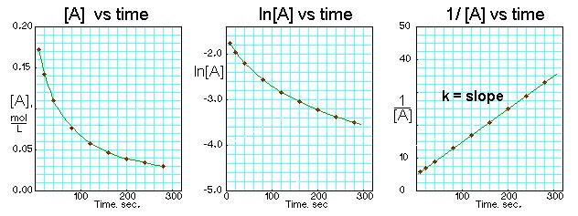
Second-Order Reactions
Δ[A]
rate = -
rate = k [A]2
[A] is the concentration of A at any time t
Δt
[A]₀ is the concentration of A at time t=0
1
1
Half life for second order
-
= kt
[A]
[A]₀
t_{½} = t when [A] = [A]₀/2
1
t_{½} =
k[A]₀
13.3

Slide 29
Second-Order
Half–life gets longer as the reaction progresses and the concentration of reactants decrease.
Each successive half–life is double the preceding one.

Slide 30
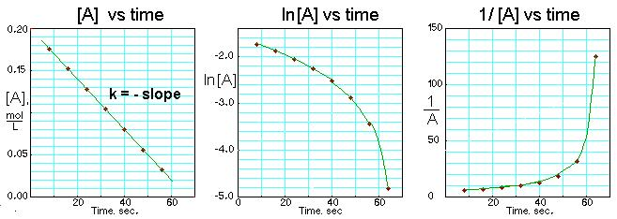
Zero-Order Reactions
Δ[A]
rate = -
rate = k [A]0 = k
Δt
[A] is the concentration of A at any time t
[A] - [A]₀ = -kt
[A]₀ is the concentration of A at time t=0
Half life for zero order
t_{½} = t when [A] = [A]₀/2
[A]₀
t_{½} =
2k
13.3

Slide 31
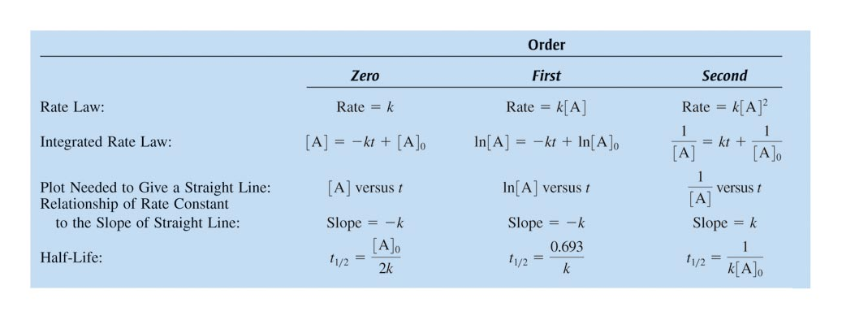
Summary of the Rate Laws

Slide 32
Reaction Mechanism
Most chemical reactions occur by a series of elementary steps.
An intermediate is formed in one step and used up in a subsequent step and thus is never seen as a product in the overall balanced reaction.

Slide 33
Reaction Intermediates
Intermediates are species that appear in a reaction mechanism but not in the overall balanced equation.
An intermediate is always formed in an early elementary step and consumed in a later elementary step.
Elementary step:
NO + NO N₂O₂
+
Elementary step:
N₂O₂ + O₂ 2NO₂
Overall reaction:
2NO + O₂ 2NO₂
13.5

Slide 34
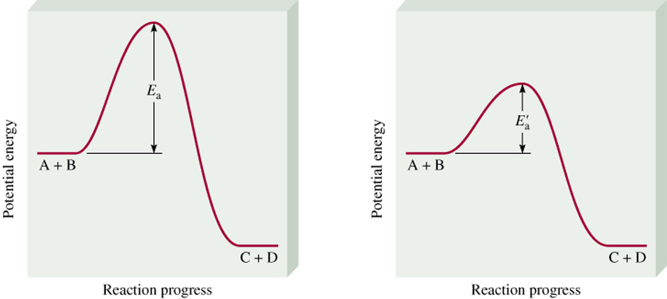
A catalyst is a substance that increases the rate of a chemical reaction without itself being consumed. It is used in an earlier step, and then later produced.
E_{a}
k
uncatalyzed
catalyzed
rate_{catalyzed} > rate_{uncatalyzed}
An inhibitor RAISES the activation energy
13.6

Slide 35
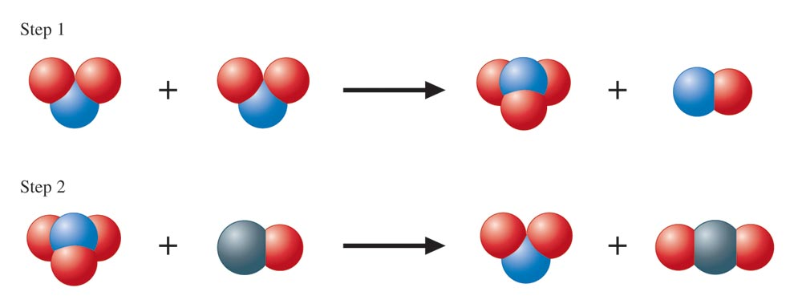
A Molecular Representation of the Elementary Steps in the Reaction of NO₂ and CO
NO₂(g) + CO(g) → NO(g) + CO₂(g)

Slide 36
Elementary Steps (Molecularity)
Unimolecular – reaction involving one molecule; first order.
Bimolecular – reaction involving the collision of two species; second order.
Termolecular – reaction involving the collision of three species; third order.

Slide 37
Rate-Determining Step
A reaction is only as fast as its slowest step.
The rate-determining step (slowest step) determines the rate law and the molecularity of the overall reaction.

Slide 38
Reaction Mechanism Requirements
The sum of the elementary steps must give the overall balanced equation for the reaction.
The mechanism must agree with the experimentally determined rate law.

Slide 39

Decomposition of N₂O₅

Slide 40
Decomposition of N₂O₅
2N₂O₅(g) → 4NO₂(g) + O₂(g)
Step 1: N₂O₅ NO₂ + NO₃ (fast)
Step 2: NO₂ + NO₃ → NO + O₂ + NO₂ (slow)
Step 3: NO₃ + NO → 2NO₂ (fast)
2( )

Slide 41
The experimental rate law for the reaction between NO₂ and CO to produce NO and CO₂ is rate = k[NO₂]2. The reaction is believed to occur via two steps:
Step 1:
NO₂ + NO₂ NO + NO₃
Step 2:
NO₃ + CO NO₂ + CO₂
What is the equation for the overall reaction?
NO₂+ CO NO + CO₂
What is the intermediate? Catalyst?
NO₃
NO₂
What can you say about the relative rates of steps 1 and 2?
rate = k[NO₂]2 is the rate law for step 1 so
step 1 must be slower than step 2
13.5

Slide 42
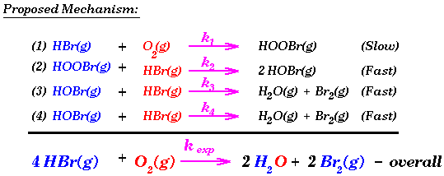
Write the rate law for this reaction.
Rate = k [HBr] [O₂]
List all intermediates in this reaction.
HOOBr, HOBr
List all catalysts in this reaction.
None

Slide 43

Concept Check
The reaction A + 2B → C has the following proposed mechanism:
A + B D (fast equilibrium)
D + B → C (slow)
Write the rate law for this mechanism.
rate = k[A][B]²
Notes:
rate = k[A][B]²
The sum of the elementary steps give the overall balanced equation for the reaction.

Slide 44
Homogeneous Catalyst
Exists in the same phase as the reacting molecules.
Enzymes are nature’s catalysts.

Slide 45

Homogeneous Catalysis

Slide 46
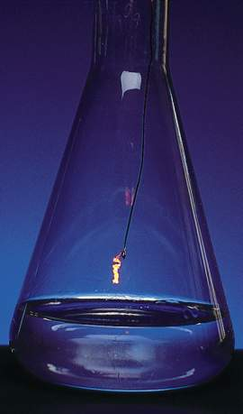
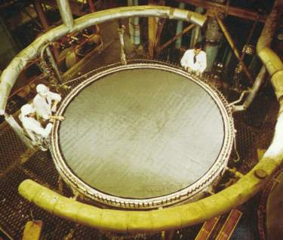
Ostwald Process
Pt catalyst
4NH₃ (g) + 5O₂ (g) 4NO (g) + 6H₂O (g)
2NO (g) + O₂ (g) 2NO₂ (g)
2NO₂ (g) + H₂O (l) HNO₂ (aq) + HNO₃ (aq)
Hot Pt wire
over NH₃ solution
Pt-Rh catalysts used
in Ostwald process
13.6

Slide 47
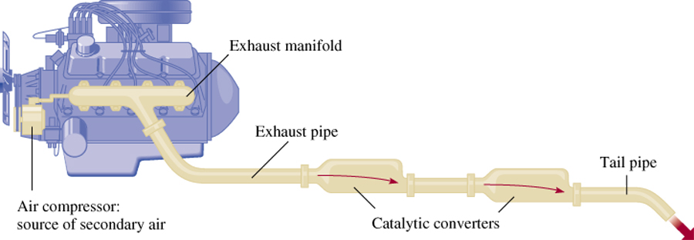
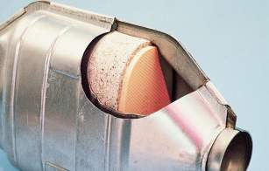
Catalytic Converters
catalytic
CO + Unburned Hydrocarbons + O₂
CO₂ + H₂O
converter
catalytic
2NO + 2NO₂
2N₂ + 3O₂
converter
13.6

Slide 48
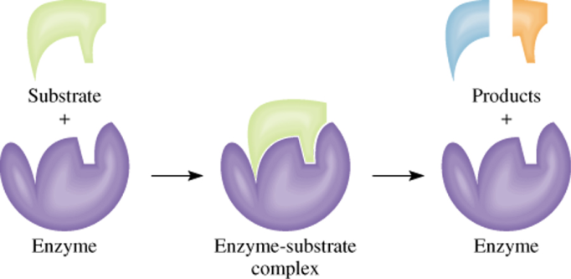
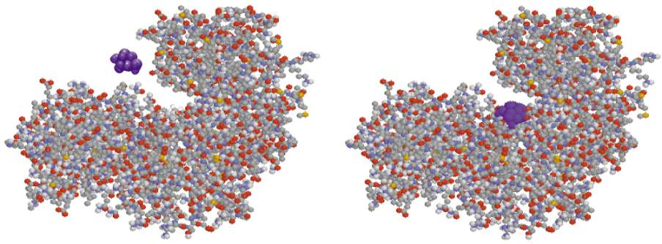
Enzyme Catalysis
13.6

Slide 49
Collision Model
Molecules must collide to react.
Main Factors:
Activation energy, E_{a}
Temperature
Molecular orientations

Slide 50
Transition States and Activation Energy

Slide 51
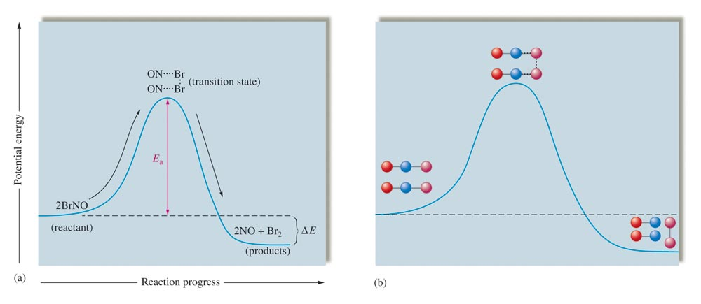
Change in Potential Energy

Slide 52
For Reactants to Form Products
Collision must involve enough energy to produce the reaction (must equal or exceed the activation energy).
Relative orientation of the reactants must allow formation of any new bonds necessary to produce products.

